Slide 1
Data Structure & Algorithms
Red Black Trees Deletion

Slide 2
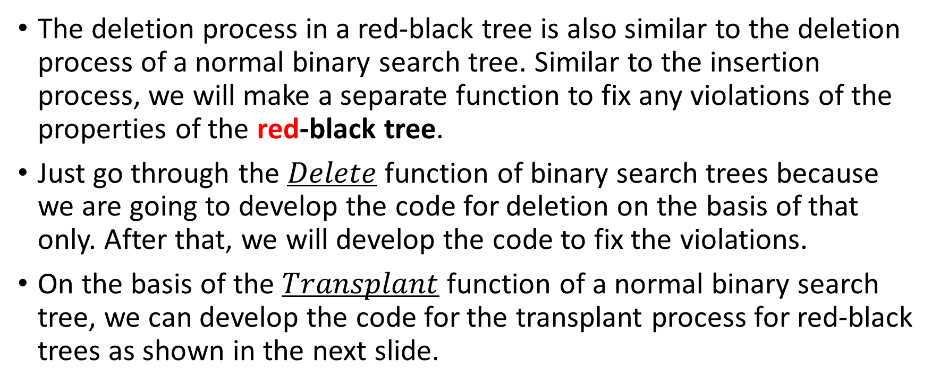
Deletion
The deletion process in a red-black tree is also similar to the deletion process of a normal binary search tree. Similar to the insertion process, we will make a separate function to fix any violations of the properties of the red-black tree.
Just go through the $Delete$ function of binary search trees because we are going to develop the code for deletion on the basis of that only. After that, we will develop the code to fix the violations.
On the basis of the $Transplant$ function of a normal binary search tree, we can develop the code for the transplant process for red-black trees as shown in the next slide.

Slide 3
RB-TRANSPLANT
RB-TRANSPLANT(T, u, v) if u.parent == T.NIL // u is root T.root = v elseif u == u.parent.left //u is left child u.parent.left = v else // u is right child u.parent.right = v v.parent = u.parent

Slide 4

RB-TRANSPLANT
As we are using $T.NIL$instead of $NULL$, the last line of the code is getting executed without checking if v is $NULL$ or not (different from binary search tree) because even if v is $T$.$NIL$, it will have an arbitrary parent and we can make that as u's parent.

Slide 5
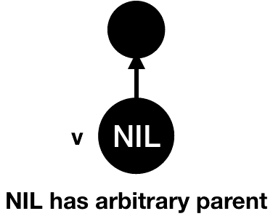
RB-TRANSPLANT

Slide 6
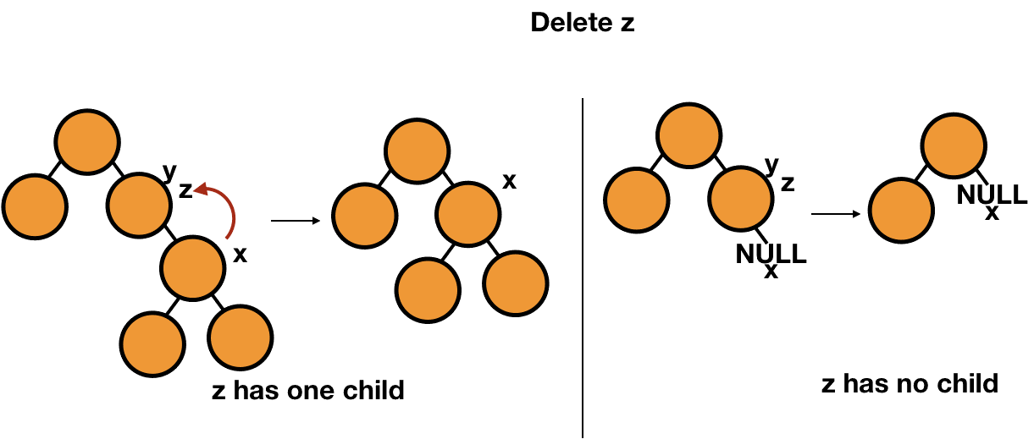
BST Delete – Review (Case 1 & 2)

Slide 7
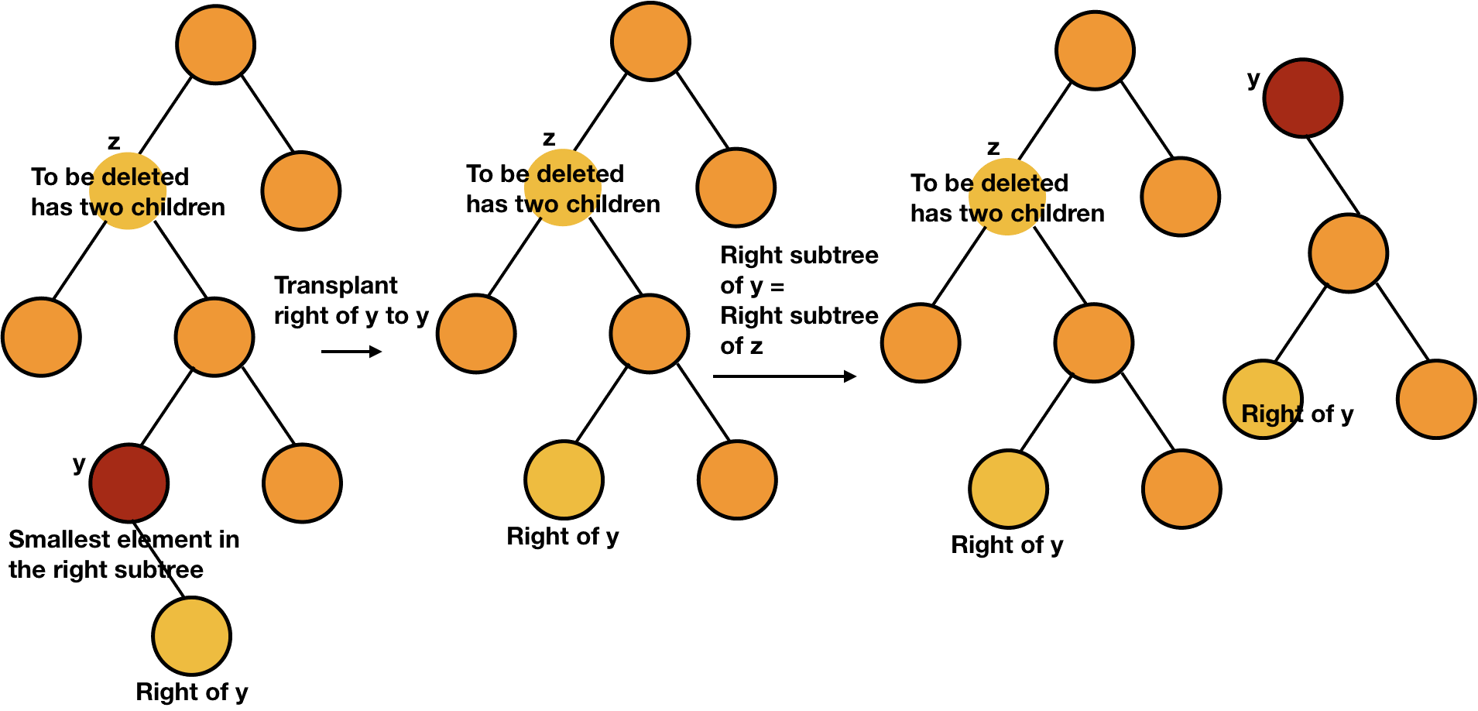
BST Delete – Review (Case 3 - Ex 1)
20
20
20
14
14
14
15
22
22
22
17
8
17
8
17
8
17
16
19
15
19
16
19
16
19
16

Slide 8
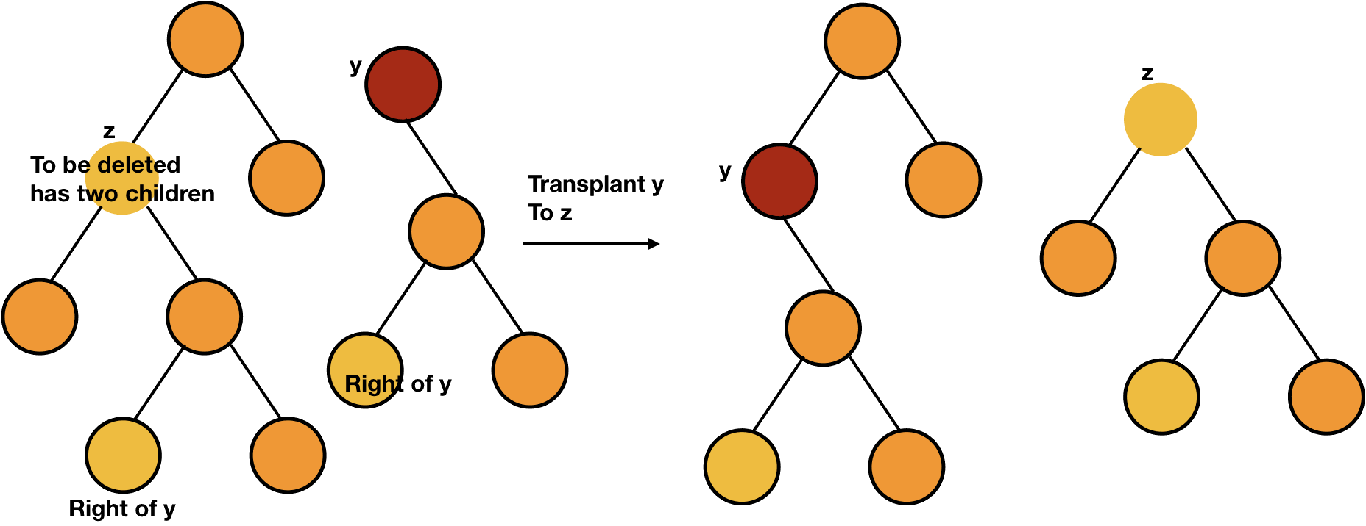
BST Delete – Review (Case 3 - Ex 1)
20
20
14
15
14
22
15
22
17
8
17
8
17
17
16
19
16
19
16
19
16
19

Slide 9
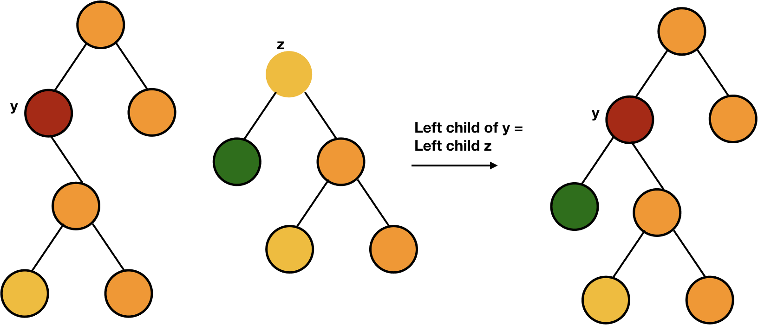
BST Delete – Review (Case 3 - Ex 1)
20
20
color y as original color of z
14
15
22
22
15
8
17
17
8
17
16
19
16
19
16
19

Slide 10
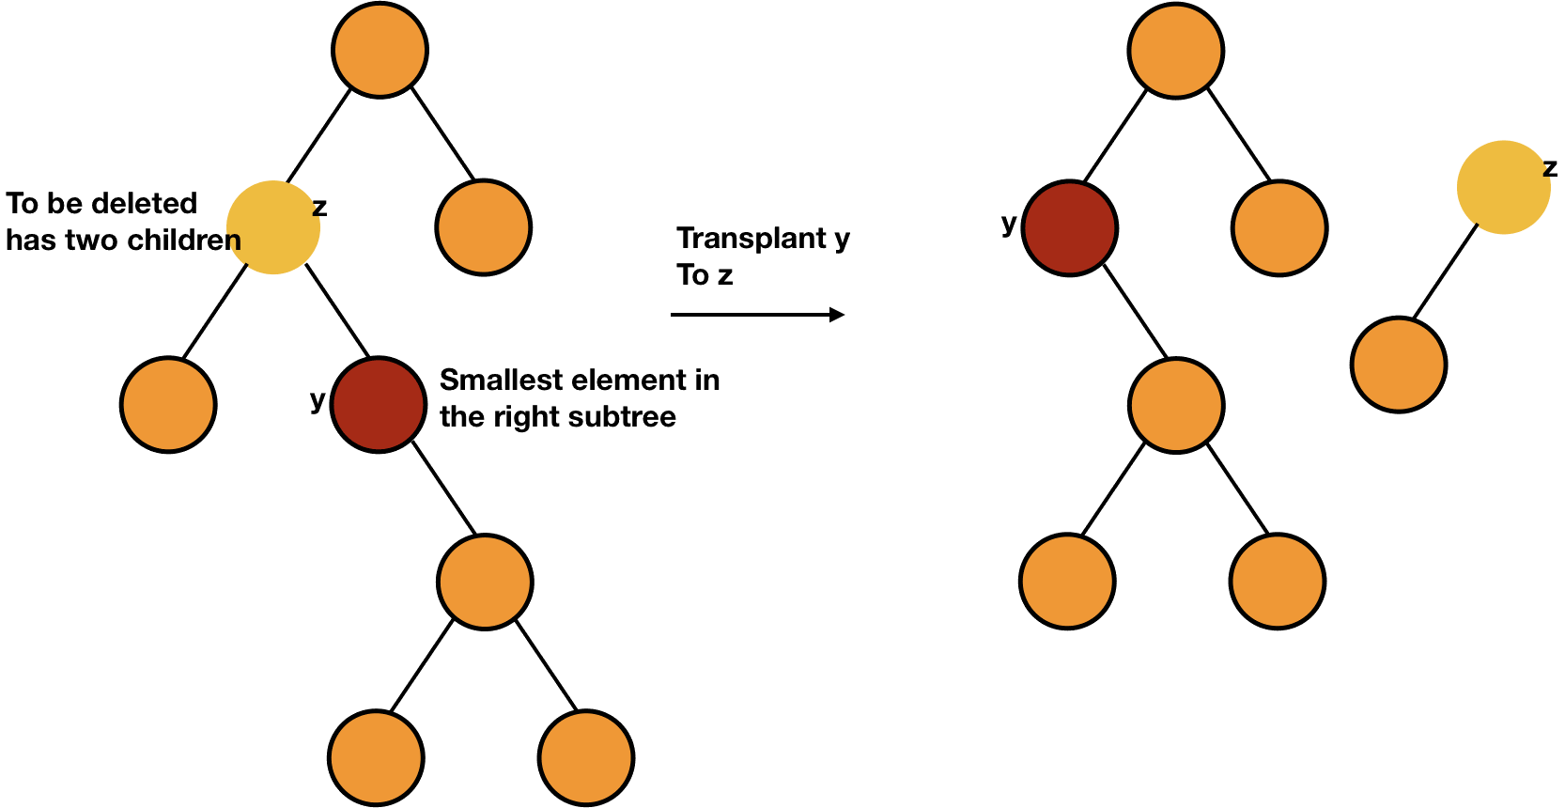
BST Delete – Review (Case 3)
20
20
12
12
22
16
22
x
3
3
16
18
x
18
17
19
x is at y’s position
17
19

Slide 11
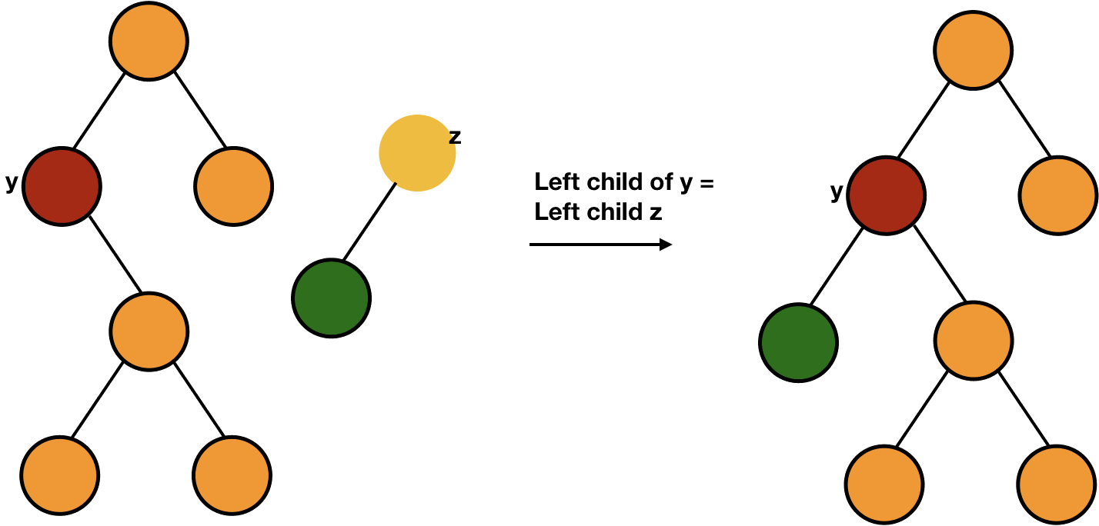
BST Delete – Review (Case 3)
20
color y as original color of z
20
12
16
22
16
16
22
x
3
x
18
18
3
3
17
19
17
19

Slide 12
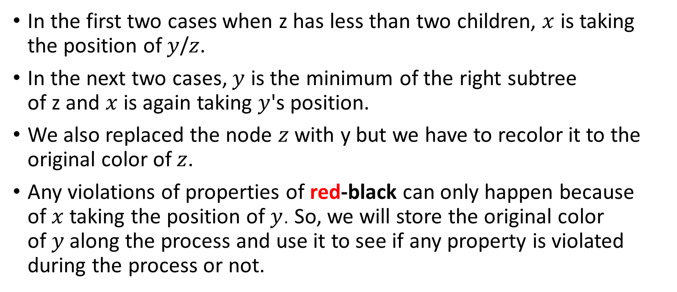
Delete Overview
In the first two cases when z has less than two children, $x$ is taking the position of $y$/$z$.
In the next two cases, $y$ is the minimum of the right subtree of z and $x$ is again taking $y$'s position.
We also replaced the node $z$ with y but we have to recolor it to the original color of $z$.
Any violations of properties of red-black can only happen because of $x$taking the position of $y$. So, we will store the original color of $y$along the process and use it to see if any property is violated during the process or not.

Slide 13
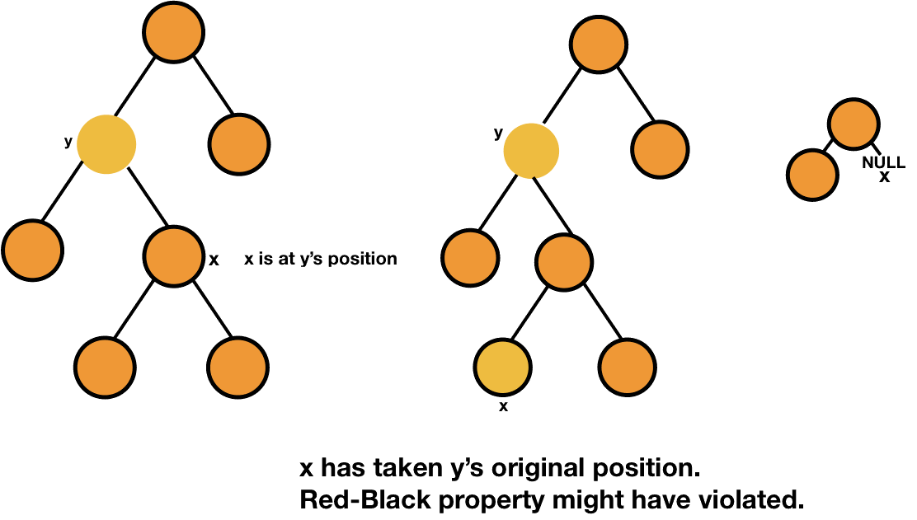
Delete Overview

Slide 14
Properties of Red-Black Trees – Review
Every node is colored either red or black.
Root of the tree is black.
All leaves are black.
Both children of a red node are black i.e., there can't be consecutive red nodes.
All the simple paths from a node to descendant leaves contain the same number of black nodes.

Slide 15
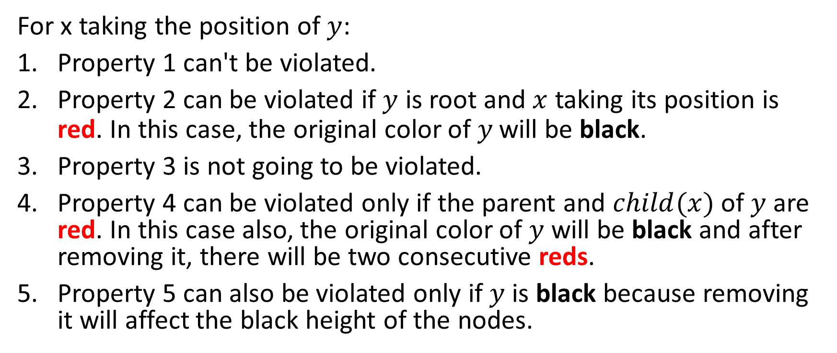
Violations Overview
For x taking the position of $y$:
Property 1 can't be violated.
Property 2 can be violated if $y$ is root and $x$ taking its position is red. In this case, the original color of $y$will be black.
Property 3 is not going to be violated.
Property 4 can be violated only if the parent and $child(x)$of $y$ are red. In this case also, the original color of $y$ will be black and after removing it, there will be two consecutive reds.
Property 5 can also be violated only if $y$ is black because removing it will affect the black height of the nodes.

Slide 16
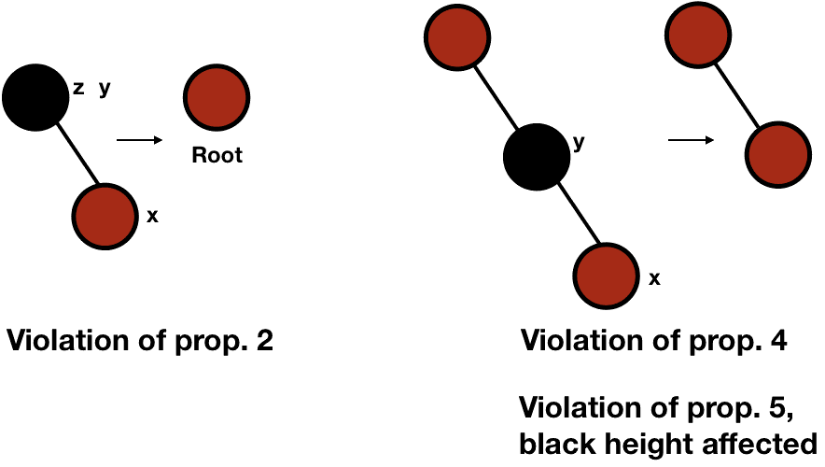
Violations Overview

Slide 17
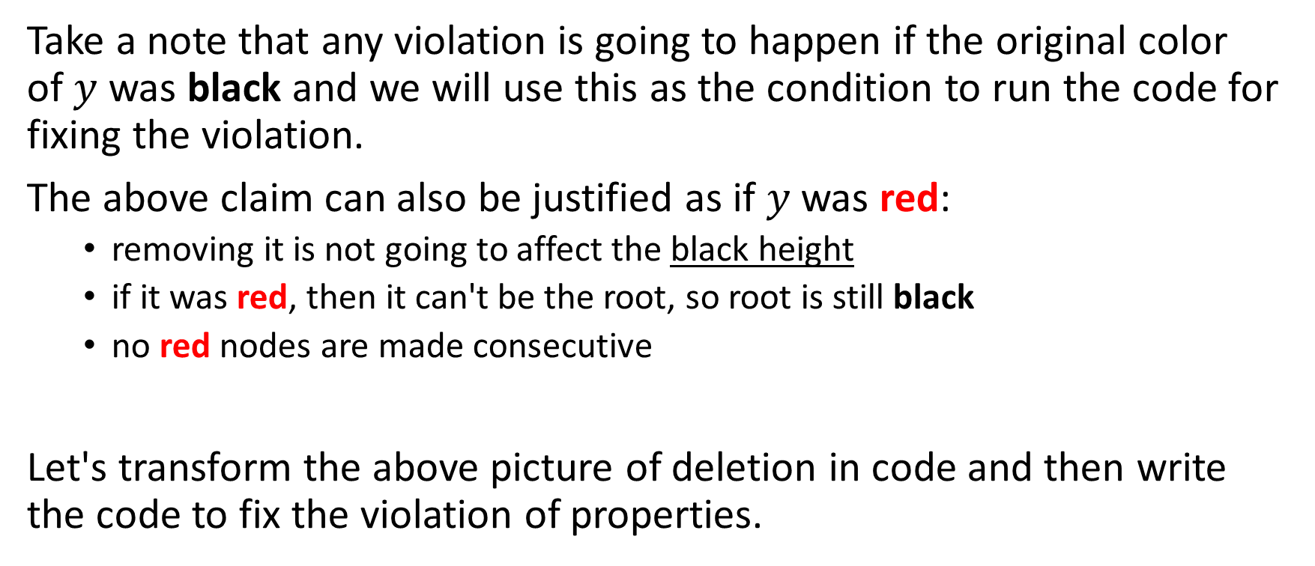
Violations Overview
Take a note that any violation is going to happen if the original color of $y$ was black and we will use this as the condition to run the code for fixing the violation.
The above claim can also be justified as if $y$was red:
removing it is not going to affect the black height
if it was red, then it can't be the root, so root is still black
no red nodes are made consecutive
Let's transform the above picture of deletion in code and then write the code to fix the violation of properties.

Slide 18
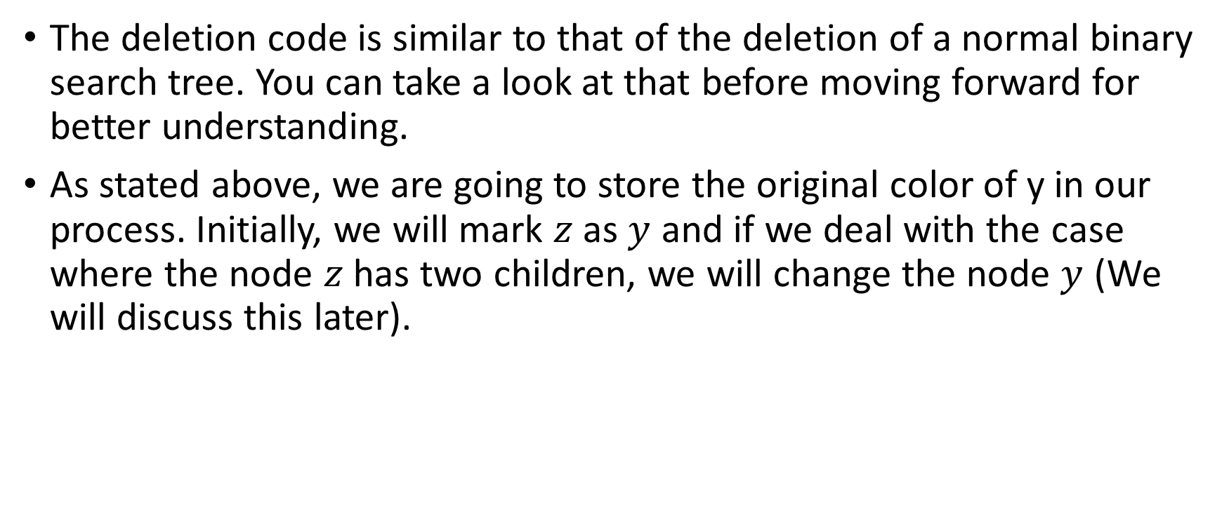
RBT Deletion Code
The deletion code is similar to that of the deletion of a normal binary search tree. You can take a look at that before moving forward for better understanding.
As stated above, we are going to store the original color of y in our process. Initially, we will mark $z$ as $y$ and if we deal with the case where the node $z$ has two children, we will change the node $y$ (We will discuss this later).
RB-DELETE(T, z) y = z y_orignal_color = y.color

Slide 19

RBT Deletion Code
After this, we will handle the case when the node $z$ has only one child similar to what we did in the delete procedure of a normal binary search tree.
RB-DELETE(T, z) ... if z.left == T.NIL //no children or only right x = z.right RB-TRANSPLANT(T, z, z.right) else if z.right == T.NIL // only left child x = z.left RB-TRANSPLANT(T, z, z.left)

Slide 20

RBT Deletion Code
If the node z has both children, then we will mark the smallest element in the $z$'s right subtree as $y$.
RB-DELETE(T, z) ... if z.left == T.NIL //no children or only right ... else if z.right == T.NIL // only left child .. else // both children y = MINIMUM(z.right) y_orignal_color = y.color x = y.right

Slide 21
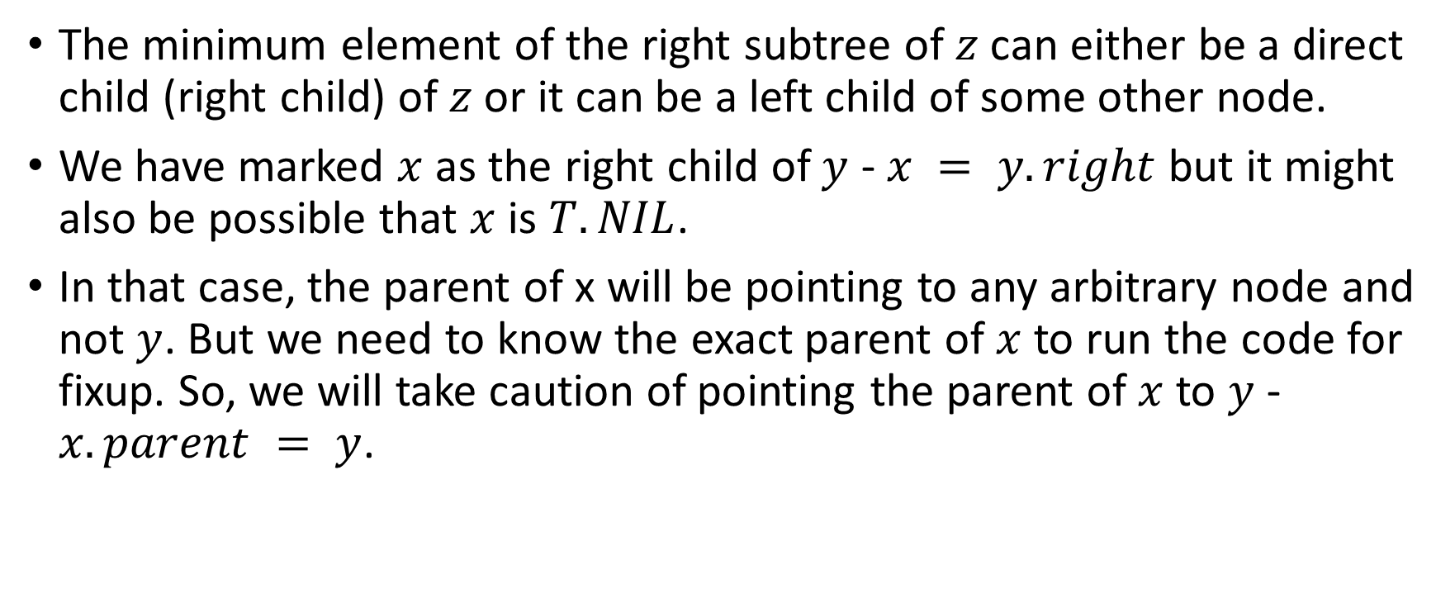
RBT Deletion Code
The minimum element of the right subtree of $z$ can either be a direct child (right child) of $z$ or it can be a left child of some other node.
We have marked $x$ as the right child of $y$ - $x = y.right$but it might also be possible that $x$ is $T.NIL$.
In that case, the parent of x will be pointing to any arbitrary node and not $y$. But we need to know the exact parent of $x$ to run the code for fixup. So, we will take caution of pointing the parent of $x$ to $y$ - $x.parent = y$.

Slide 22

RBT Deletion Code
If $y$ is the direct child of $z$, we will make y as the parent of $x$right away. In the other case, it will be done further in the process.
RB-DELETE(T, z) ... if z.left == T.NIL //no children or only right ... else if z.right == T.NIL // only left child .. else // both children ... if y.parent == z // y is direct child of z x.parent = y

Slide 23

RBT Deletion Code
If $y$ is not the direct child of $z$, we will first transplant the right subtree of $y$ to $y$ - $RB−TRANSPLANT(T, y, y.right).$
After this, we will change the right of $y$ to right of $z$.
After this we can transplant $y$ to $z$ in both cases (whether $y$ is direct child or not).
RB-DELETE(T, z) ... ... if y.parent == z // y is direct child of z x.parent = y else RB-TRANSPLANT(T, y, y.right) y.right = z.right y.right.parent = y RB-TRANSPLANT(T, z, y)

Slide 24

RBT Deletion Code
Next, we will put the left of $z$ to left of $y$ and color $y$as $z$.
RB-DELETE(T, z) ... ... if y.parent == z // y is direct child of z x.parent = y else ... RB-TRANSPLANT(T, z, y) y.left = z.left y.left.parent = y y.color = z.color

Slide 25

RBT Deletion Code
At last, we will call the function to fix the violation if the original color of $y$ was black (as discussed above).
RB-DELETE(T, z) ... if y_orignal_color == black RB-DELETE-FIXUP(T, x)

Slide 26
RB-DELETE
RB-DELETE(T, z) y = z y_orignal_color = y.color if z.left == T.NIL //no children or only right x = z.right RB-TRANSPLANT(T, z, z.right) else if z.right == T.NIL // only left child x = z.left RB-TRANSPLANT(T, z, z.left) else // both children y = MINIMUM(z.right) y_orignal_color = y.color x = y.right if y.parent == z // y is direct child of z x.parent = y else RB-TRANSPLANT(T, y, y.right) y.right = z.right y.right.parent = y RB-TRANSPLANT(T, z, y) y.left = z.left y.left.parent = y y.color = z.color if y_orignal_color == black RB-DELETE-FIXUP(T, x)

Slide 27
Fixing Violation of Red-Black Tree in Deletion
The violation of the property 5 (change in black height) is our main concern. We are going to deal it with a bit different way. We are going to say that the property 5 has not been violated and the node x which is now occupying y's original position has an "extra black" in it. In this way, the property of black height is not violated but the property 1 i.e., every node should be either black or red is violated because the node x is now either "double black" (if it was black) or red and black (if it was red).

Slide 28
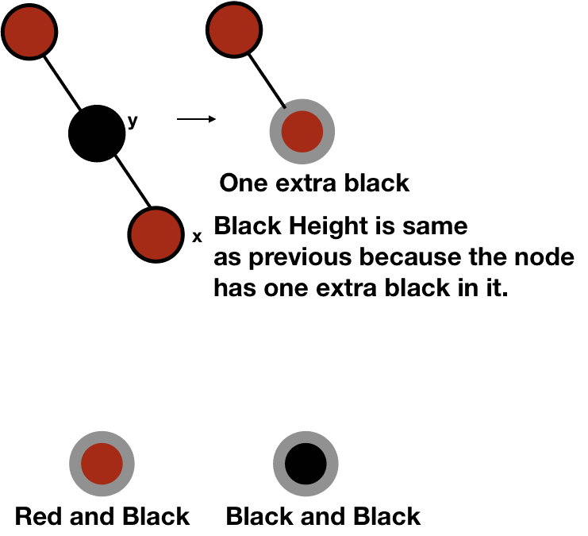
Fixing Violation of Red-Black Tree in Deletion

Slide 29
Fixing Violation of Red-Black Tree in Deletion
With this thinking, we can say that either property 1, 2 or 4 can be violated.
If x is red and black, we can simply color it black and this will fix the violation of the property 1 without causing any other violation. This will also solve the violation of the property 4.
If x is the root, we can simply remove the one extra black and thus, fixing the violation of the property 1.
With the above two mentioned cases, violations of properties 2 and 4 are completely solved and now we can focus only on solving the violation of property 1.

Slide 30
Fixing Violation of Red-Black Tree in Deletion
There can be 4 cases (w is x's sibling):
w is red.
w is black and its both children are black.
w is black and its right child is black and left child is red.
w is black and its right child is red.

Slide 31
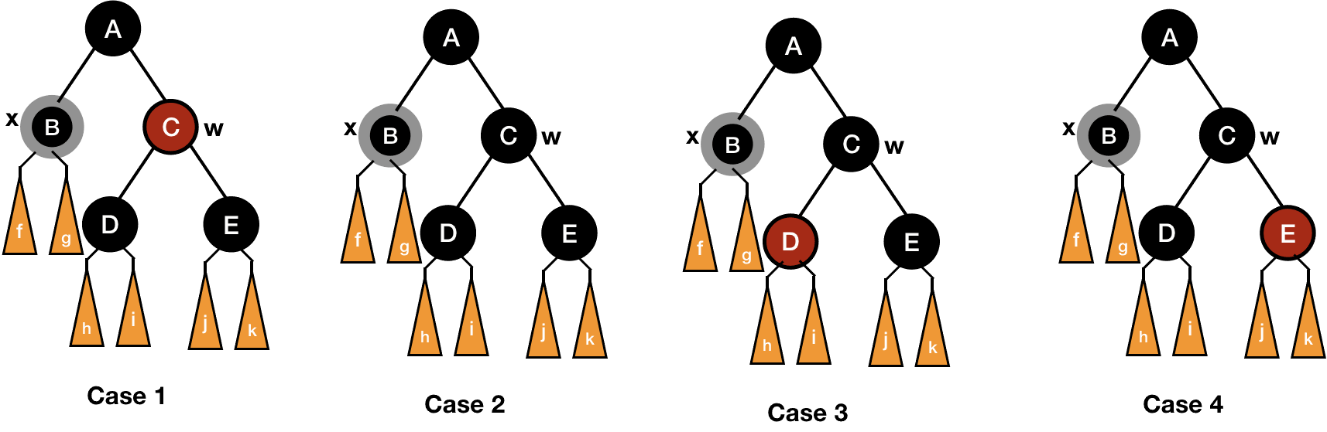
Fixing Violation of Red-Black Tree in Deletion

Slide 32
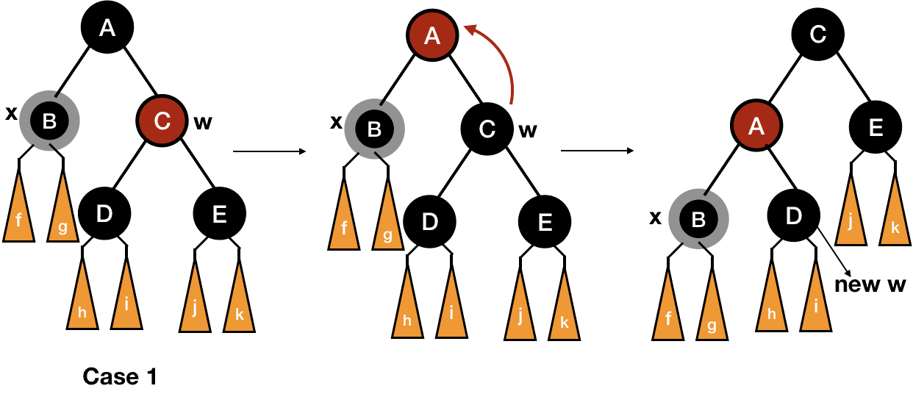

Fixing Violation of Red-Black Tree in Deletion
For the first case, we can switch the colors of $w$ and its parent and then left rotate the parent of $x$. In this way, we will enter either case 2, 3 or 4.

Slide 33
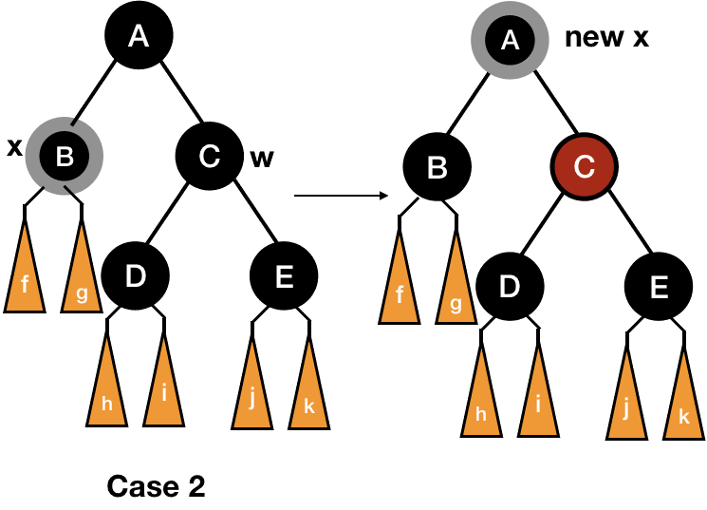
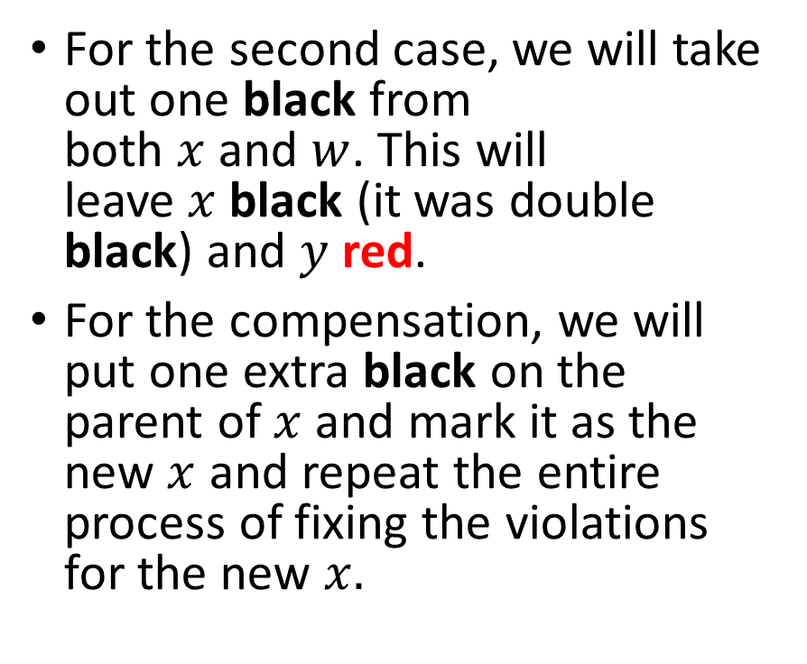
Fixing Violation of Red-Black Tree in Deletion
For the second case, we will take out one black from both $x$ and $w$. This will leave $x$ black (it was double black) and $y$ red.
For the compensation, we will put one extra black on the parent of $x$ and mark it as the new $x$ and repeat the entire process of fixing the violations for the new $x.$

Slide 34
Fixing Violation of Red-Black Tree in Deletion
Also if we have entered case 2 from case 1, the parent must be red and now red and black, so it will be simply fixed by coloring it black.

Slide 35
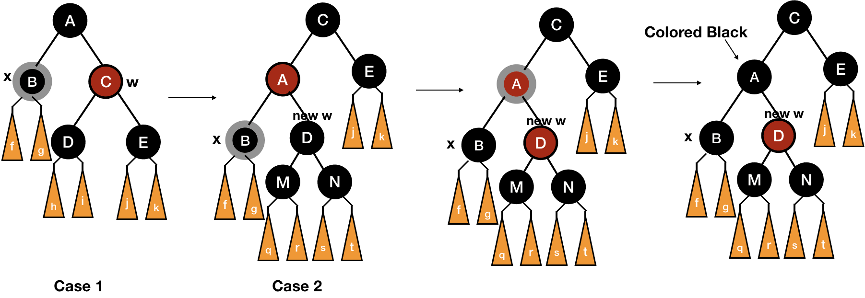
Fixing Violation of Red-Black Tree in Deletion

Slide 36
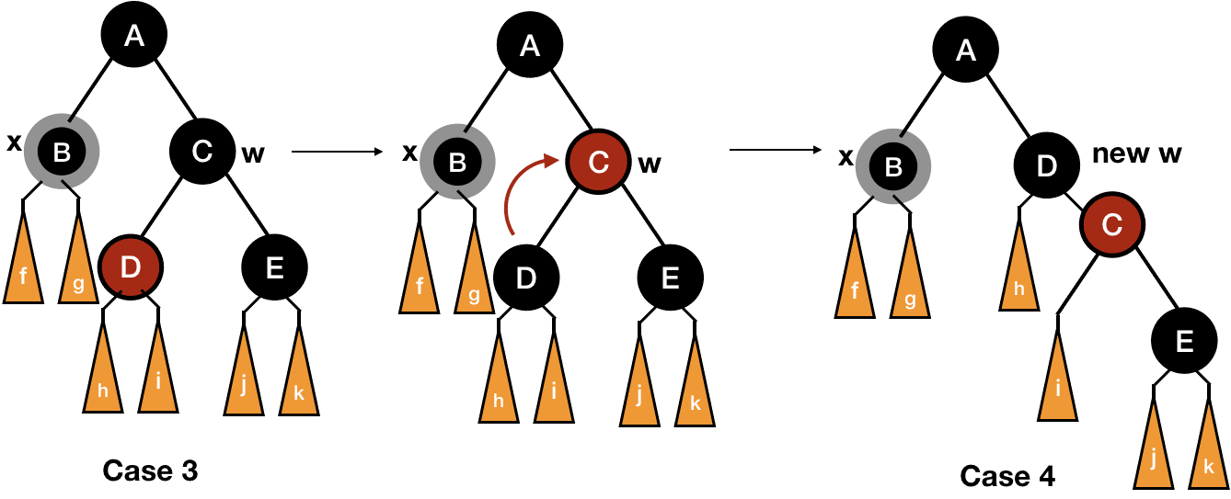

Fixing Violation of Red-Black Tree in Deletion
We will transform case 3 to case 4 by switching the colors of $w$ and its left child and then rotating right $w$.

Slide 37
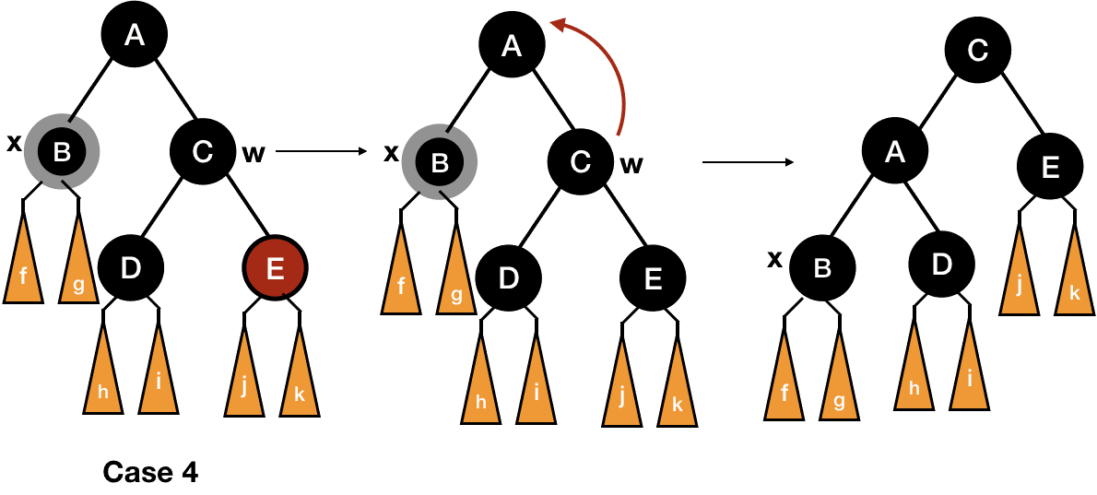
Fixing Violation of Red-Black Tree in Deletion
For case 4, take a look at the following picture:

Slide 38
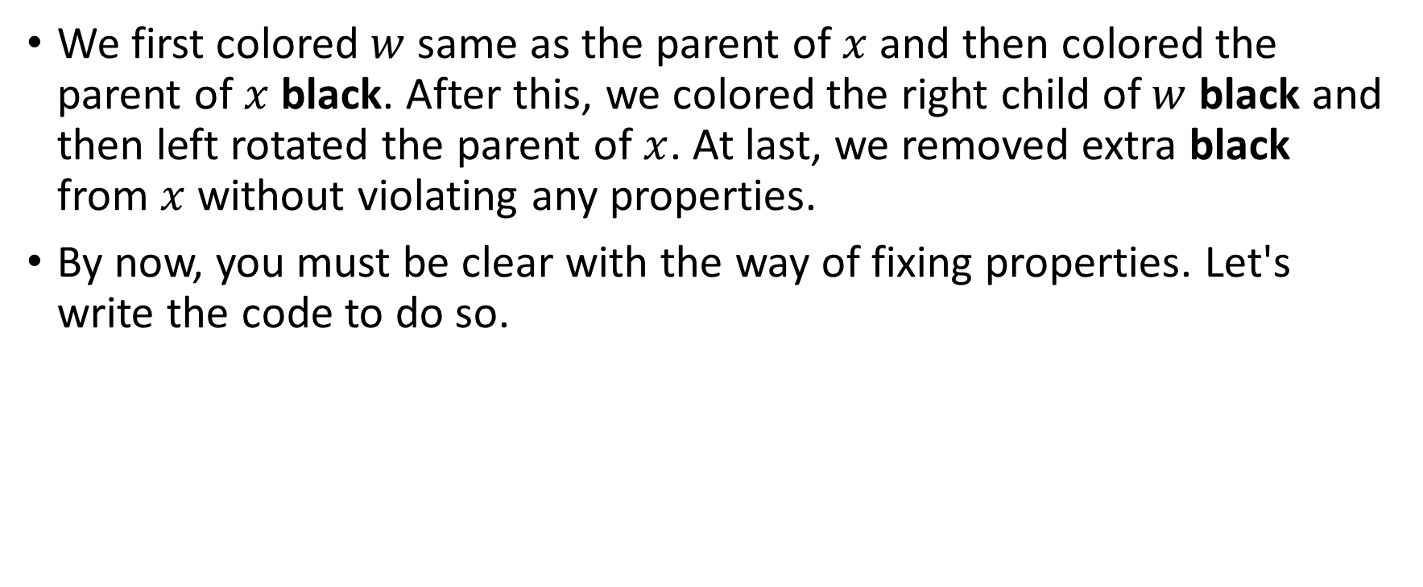
Fixing Violation of Red-Black Tree in Deletion
We first colored $w$ same as the parent of $x$ and then colored the parent of $x$ black. After this, we colored the right child of $w$ black and then left rotated the parent of $x$. At last, we removed extra black from $x$ without violating any properties.
By now, you must be clear with the way of fixing properties. Let's write the code to do so.

Slide 39
RB-DELETE-FIXUP
RB-DELETE-FIXUP(T, x) while x!= T.root and x.color == black if x == x.parent.left w = x.parent.right if w.color == red //case 1 w.color = black x.parent.color = red LEFT-ROTATE(T, x.parent) w = x.parent.right if w.left.color == black and w.right.color == black //case 2 w.color = red x = x.parent

Slide 40
RB-DELETE-FIXUP
else //case 3 or 4 if w.right.color == black //case 3 w.left.color = black w.color = red RIGHT-ROTATE(T, w) w = x.parent.right //case 4 w.color = x.parent.color x.parent.color = black w.right.color = black LEFT-ROTATE(T, x.parent) x = T.root else code will be symmetric x.color = black

Slide 41
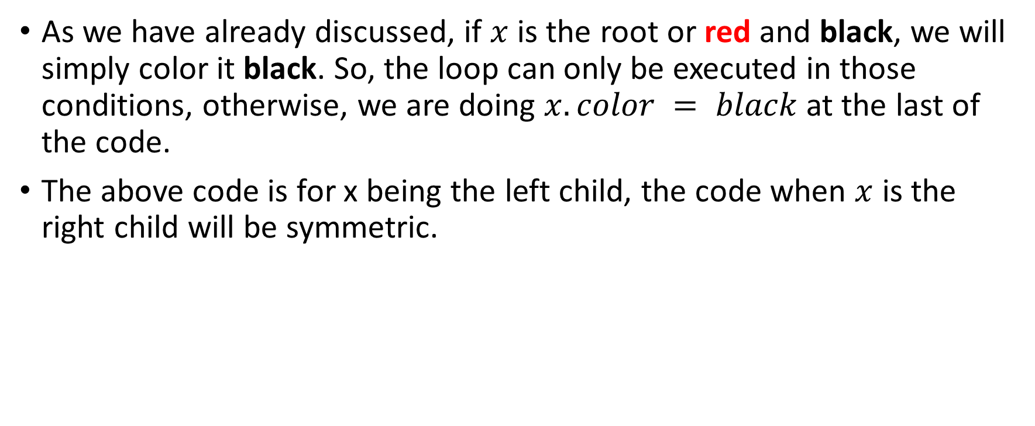
RB-DELETE-FIXUP
As we have already discussed, if $x$ is the root or red and black, we will simply color it black. So, the loop can only be executed in those conditions, otherwise, we are doing $x.color = black$at the last of the code.
The above code is for x being the left child, the code when $x$ is the right child will be symmetric.

Slide 42
RB-Delete Code in C
void rb_transplant(red_black_tree *t, tree_node *u, tree_node *v) { if(u->parent == t->NIL) t->root = v; else if(u == u->parent->left) u->parent->left = v; else u->parent->right = v; v->parent = u->parent; } tree_node* minimum(red_black_tree *t, tree_node *x) { while(x->left != t->NIL) x = x->left; return x; }

Slide 43
RB-Delete Code in C
void rb_delete(red_black_tree *t, tree_node *z) { tree_node *y = z; tree_node *x; enum COLOR y_orignal_color = y->color; if(z->left == t->NIL) { x = z->right; rb_transplant(t, z, z->right); } else if(z->right == t->NIL) { x = z->left; rb_transplant(t, z, z->left); } else { y = minimum(t, z->right); y_orignal_color = y->color; x = y->right; if(y->parent == z) { x->parent = z; } else { rb_transplant(t, y, y->right); y->right = z->right; y->right->parent = y; } rb_transplant(t, z, y); y->left = z->left; y->left->parent = y; y->color = z->color; } if(y_orignal_color == Black) rb_delete_fixup(t, x); }

Slide 44
RB-Delete Code in C
void rb_delete_fixup(red_black_tree *t, tree_node *x) { while(x != t->root && x->color == Black) { if(x == x->parent->left) { tree_node *w = x->parent->right; if(w->color == Red) { w->color = Black; x->parent->color = Red; left_rotate(t, x->parent); w = x->parent->right; } if(w->left->color == Black && w->right->color == Black) { w->color = Red; x = x->parent; } else { if(w->right->color == Black) { w->left->color = Black; w->color = Red; right_rotate(t, w); w = x->parent->right; } w->color = x->parent->color; x->parent->color = Black; w->right->color = Black; left_rotate(t, x->parent); x = t->root; }

Slide 45
RB-Delete Code in C
} else { tree_node *w = x->parent->left; if(w->color == Red) { w->color = Black; x->parent->color = Red; right_rotate(t, x->parent); w = x->parent->left; } if(w->right->color == Black && w->left->color == Black) { w->color = Red; x = x->parent; } else { if(w->left->color == Black) { w->right->color = Black; w->color = Red; left_rotate(t, w); w = x->parent->left; } w->color = x->parent->color; x->parent->color = Black; w->left->color = Black; right_rotate(t, x->parent); x = t->root; } } } x->color = Black; }

